Slide 1
CMSE 201 Final Project
Section – 006
Rodrigo Lara

Slide 2
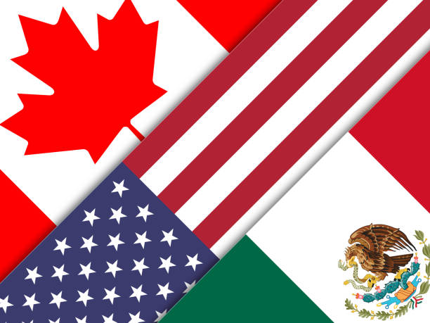
Background and Motivation
North America Free Trade Agreement
Came into force in January 1, 1994
Eliminate or reduce the barriers to trade and invest between the U.S., Canada, and Mexico

Slide 3
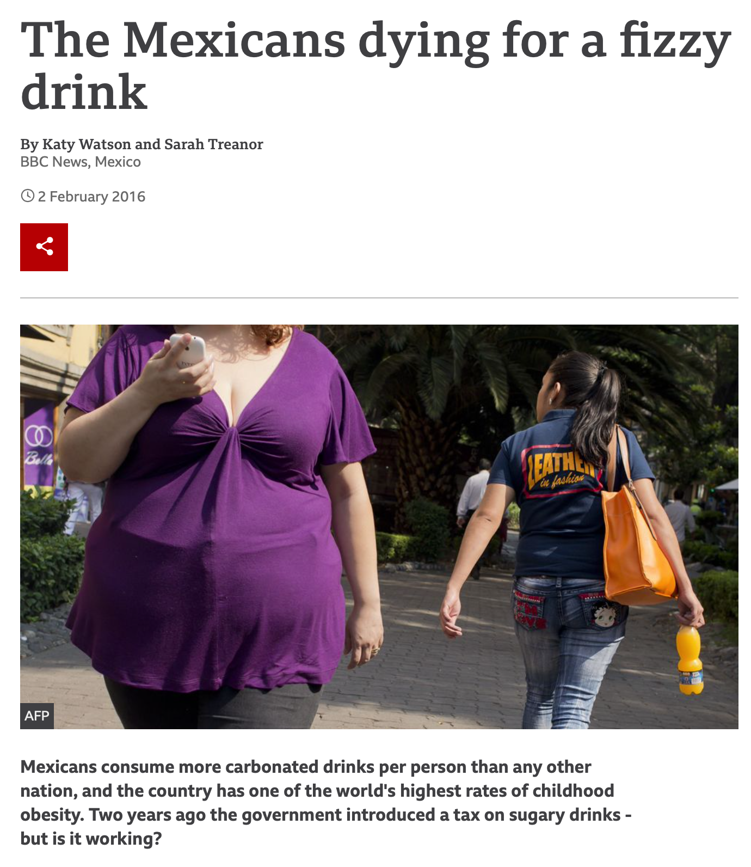
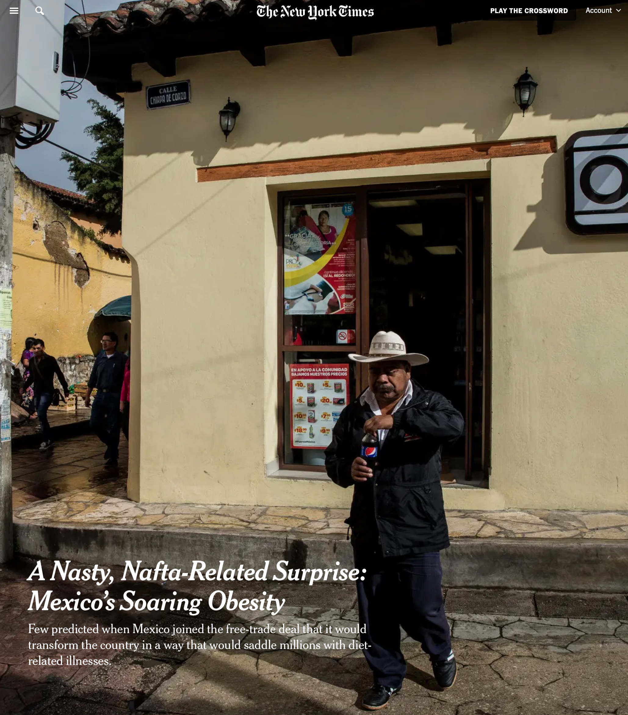
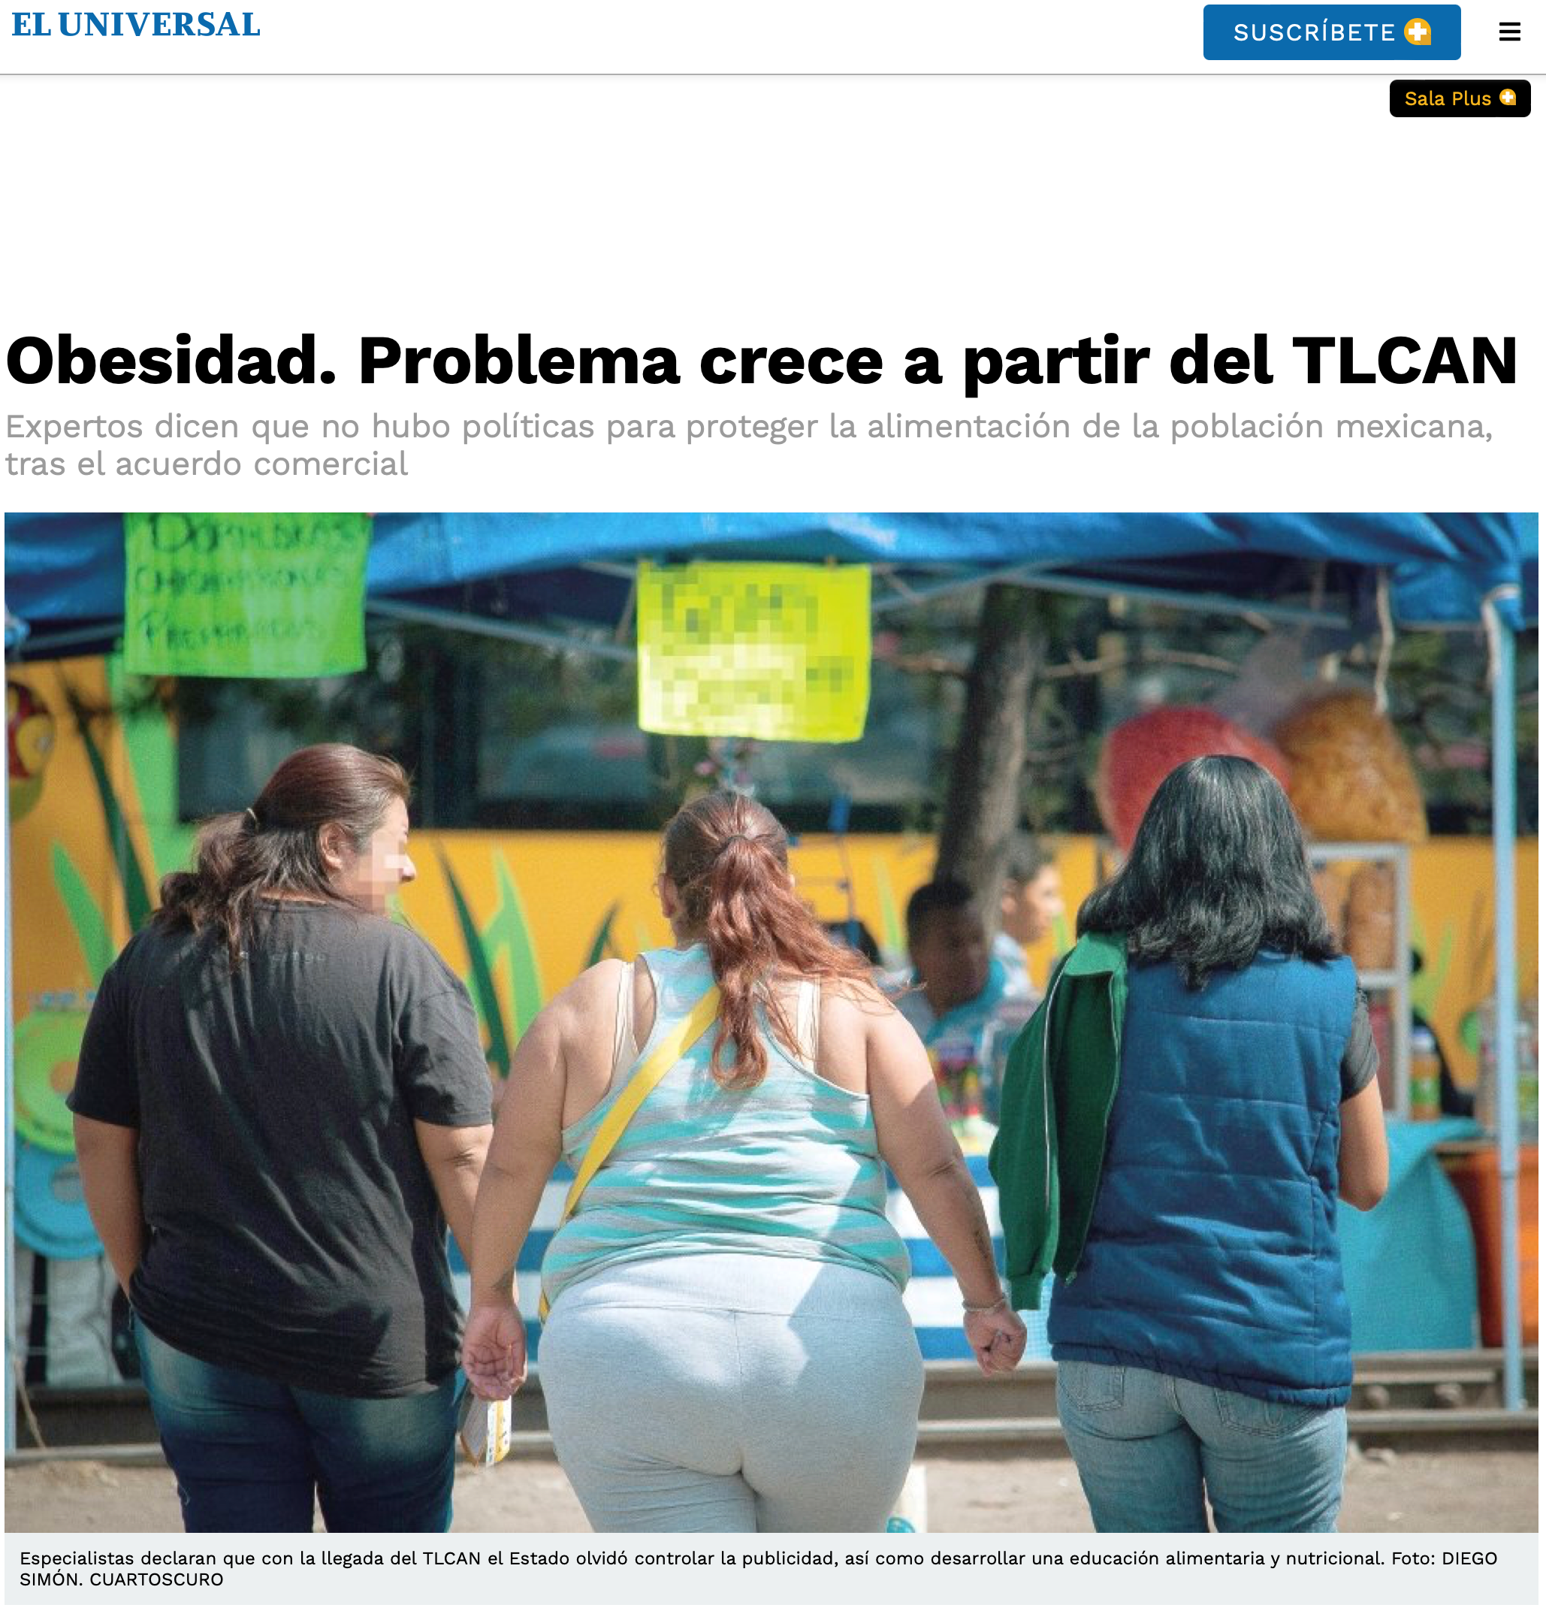
Investigation
Obesity. Problem starts with NAFTA

Slide 4
Has NAFTA caused a spike of obesity in Mexico?

Slide 5
Methodology

Slide 6
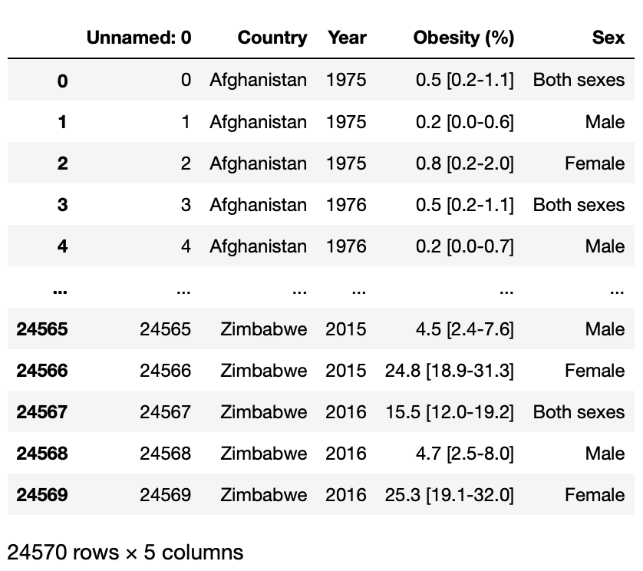
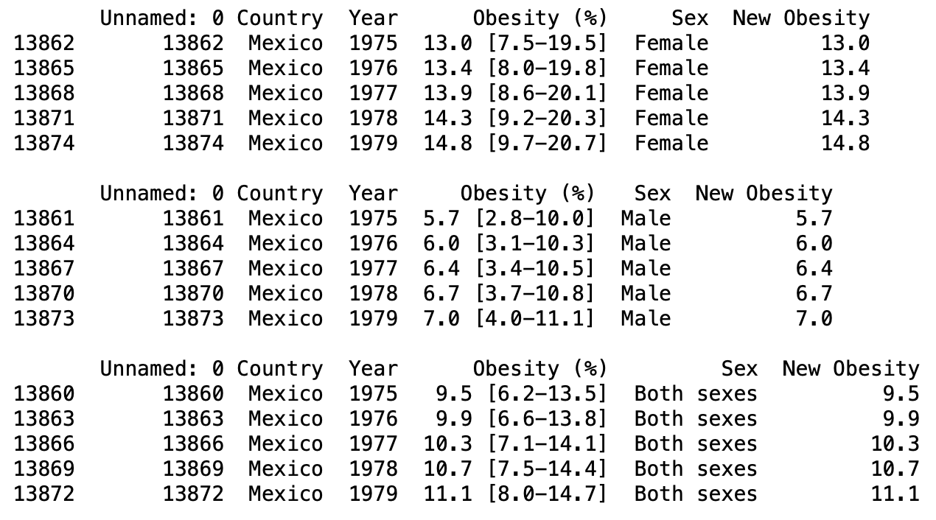
Raw Data; Obesity percent by country, by sexes, throughout time
Clean Data
Showing only data for Mexico
Divided Obesity(%) string and created a new column
Divided by the sexes and both

Slide 7
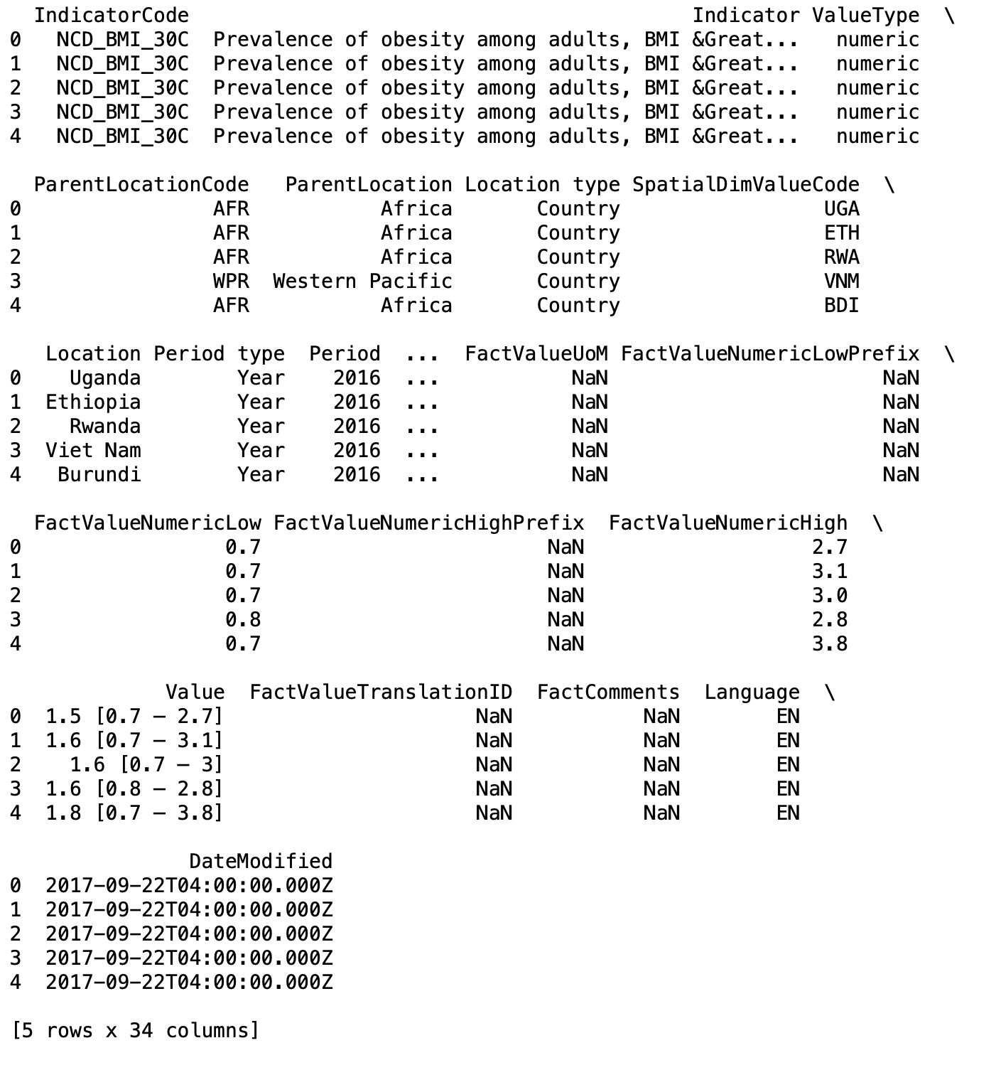
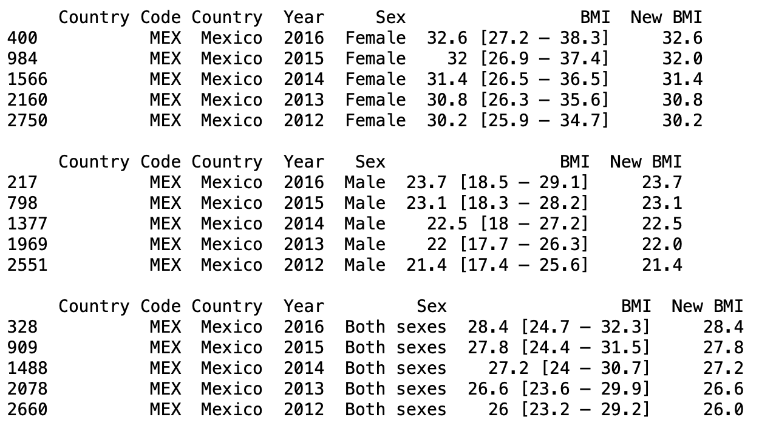
Raw Data; Average BMI by country, by sexes, throughout time
Clean Data
Removed unnecessary columns
Showing only data for Mexico
Divided BMI string and created a new column
Divided by the sexes and both

Slide 8
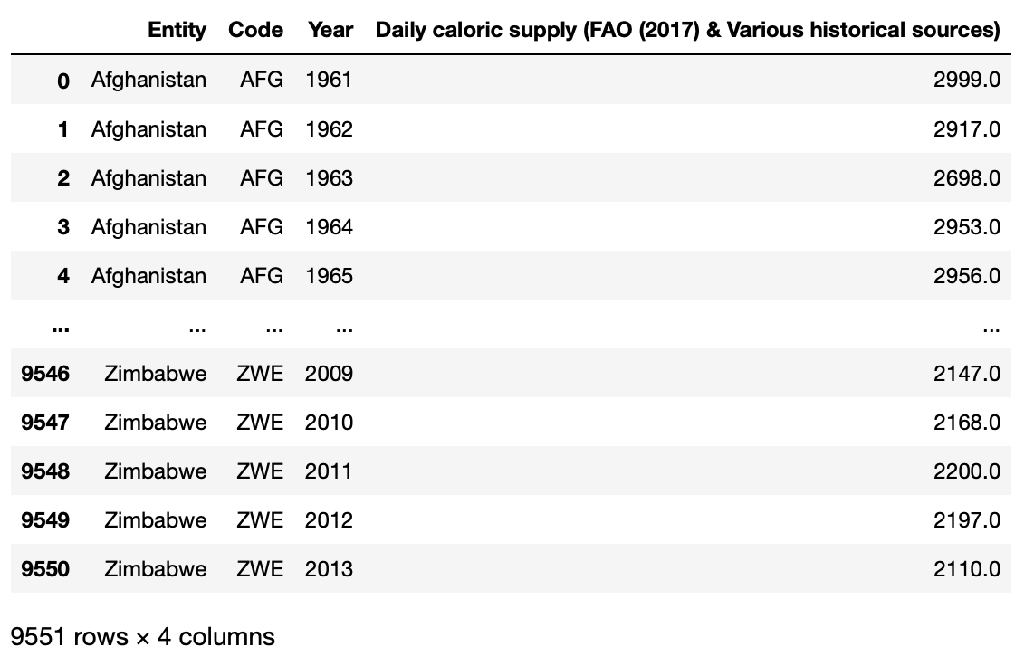
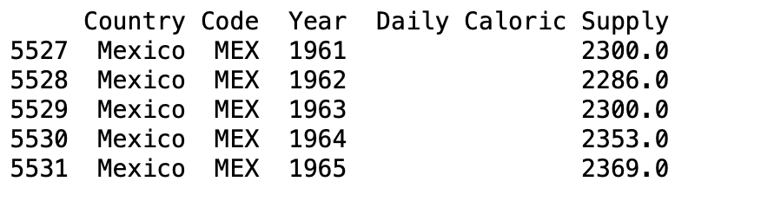
Raw Data; Daily Caloric Supply per person per day throughout time
Cleaned Data
Showing only data for Mexico

Slide 9
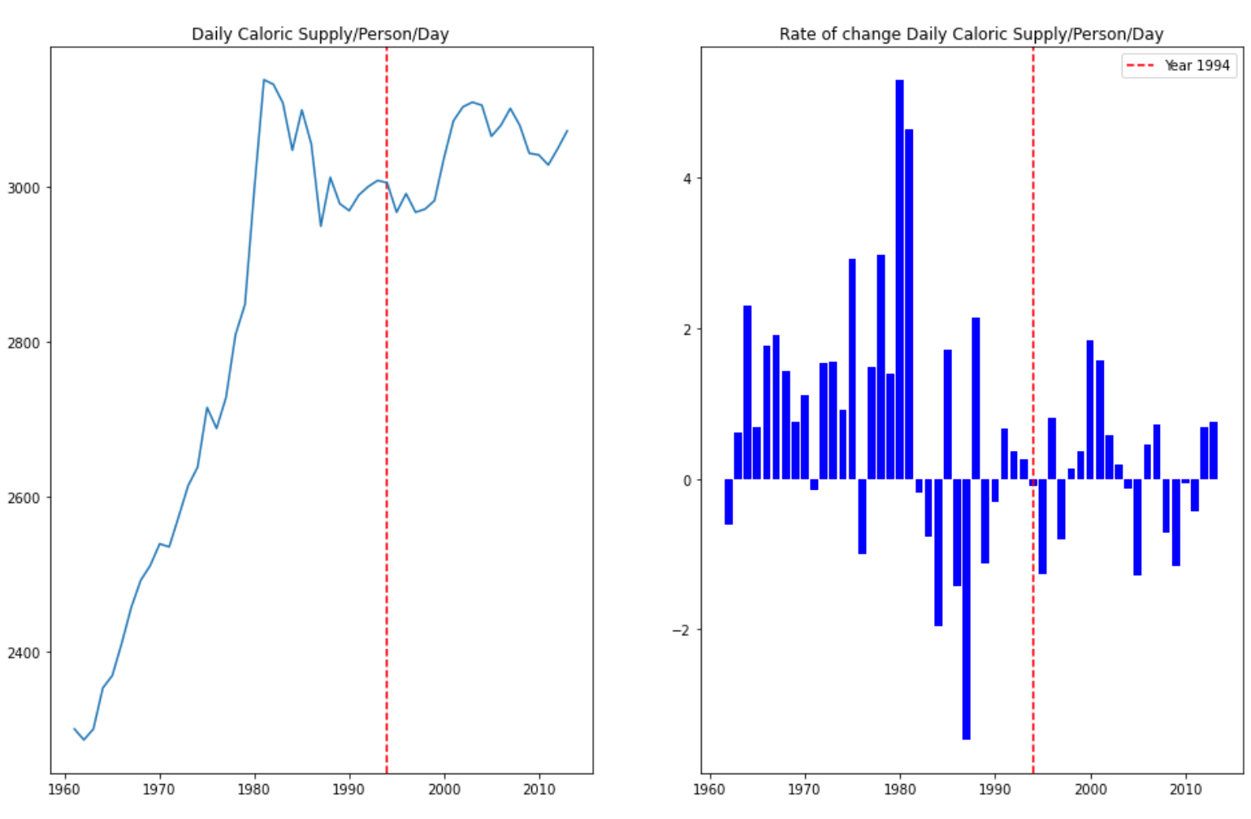
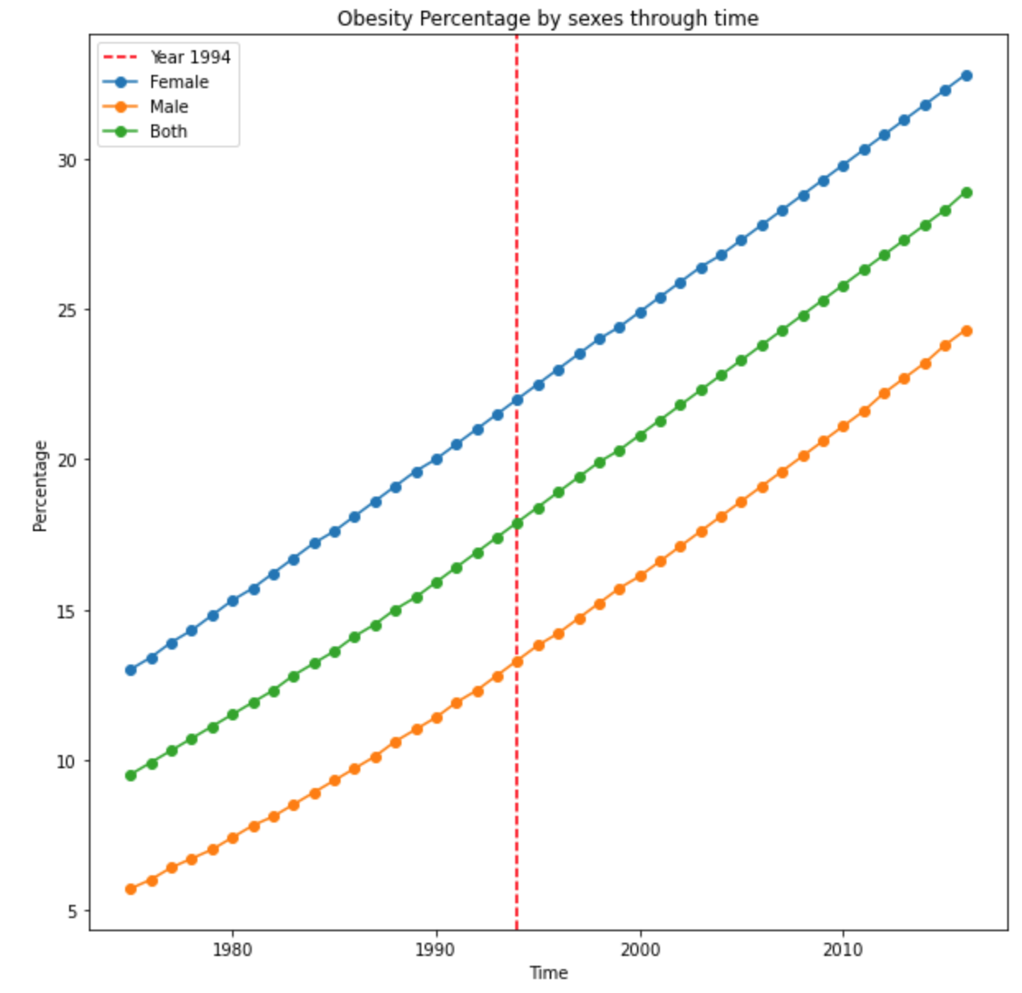
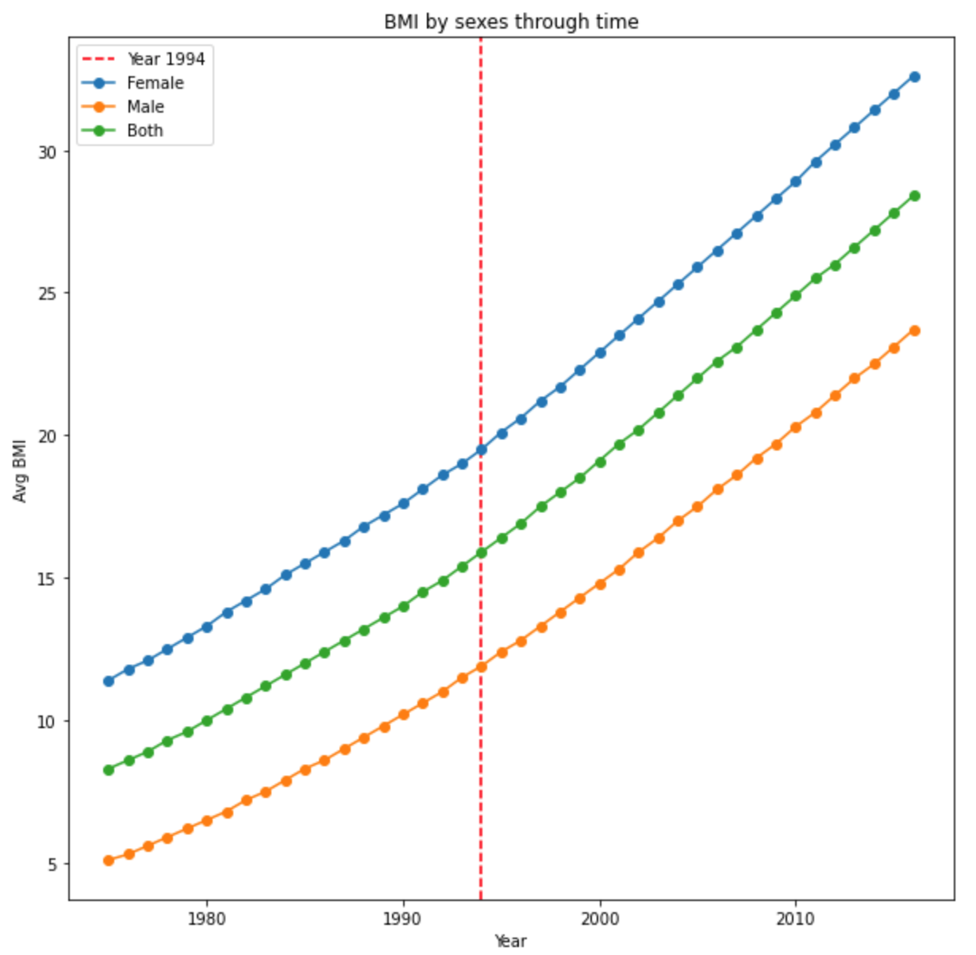
Results

Slide 10
Conclusion
Obesity Percent had linear growth with no anomalies after NAFTA
BMI had linear growth with no anomalies after NAFTA
Avg. Caloric Consumption has its growth and peak long before NAFTA
NAFTA did NOT cause a spike of obesity in Mexico

